Slide 1
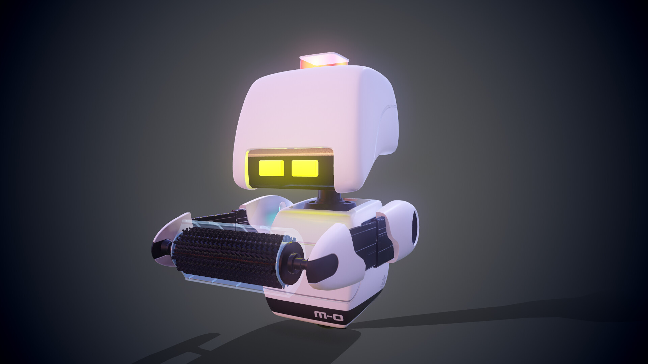
MTRX 2700
Assignment 3

Slide 2

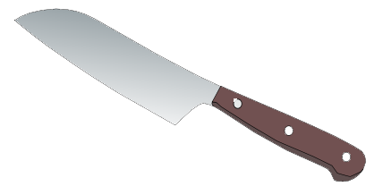

Slide 3
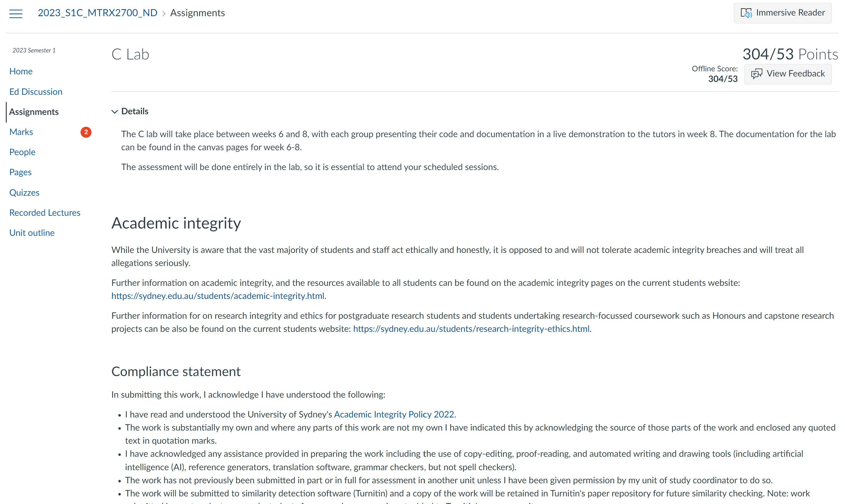

Slide 4
COUNTDOWN TILL STEWART ARRIVES
MTRX SUBJECT SELECTOR
STEWART’S MUSICAL CHALLENGE
CHANGE OUR MARKS

Slide 5
7-SEG TIMER
JOYSTICK + PTU + LIDAR
CAPACITIVE TOUCH
KEYPAD + SERIAL

Slide 6
MODULE | 7-SEG TIMER + BUZZER

Slide 7
module interfaces (software elements)

Slide 8
MODULE | JOYSTICK + PTU + LIDAR

Slide 9
MODULE | CAPACITIVE TOUCH

Slide 10
MODULE | KEYPAD + SERIAL

